Slide 1
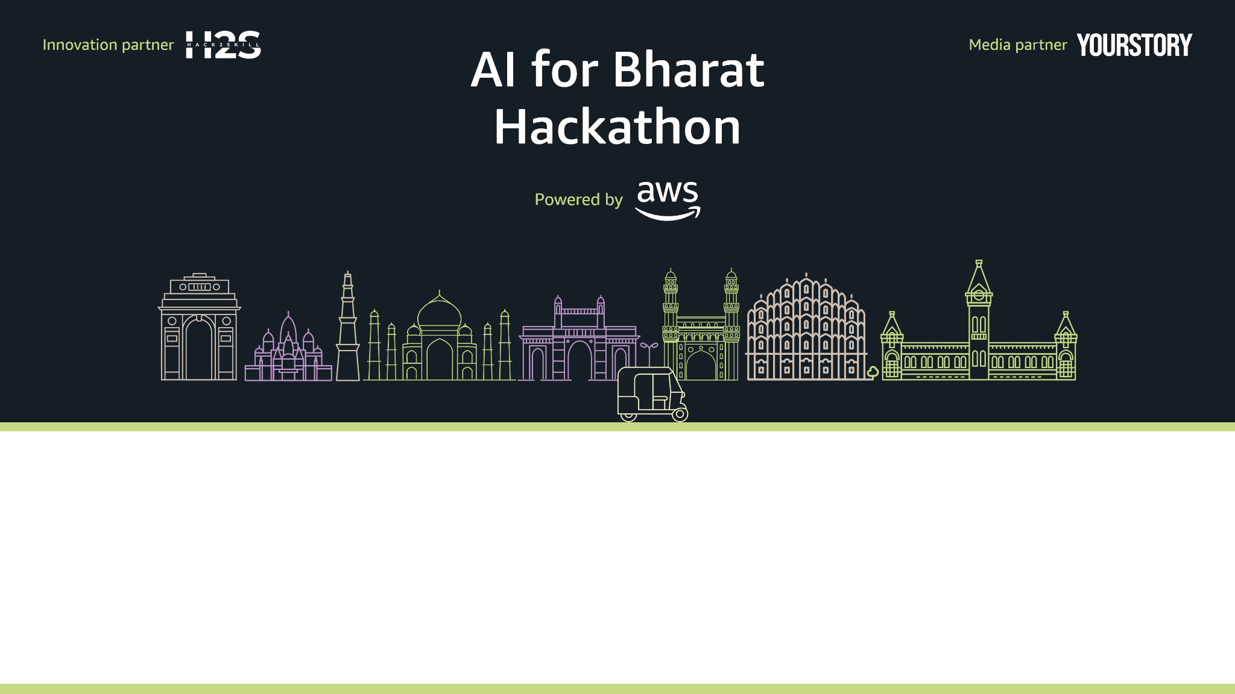
Team Name : ProGirls
Team Leader Name : Anwesha
Problem Statement : Rural areas face three critical barriers: abstract curriculum disconnected from real life, limited internet access preventing digital learning, and zero visibility into career pathways. The result? 78% never discover their potential, and India loses millions of innovators annually.

Slide 2
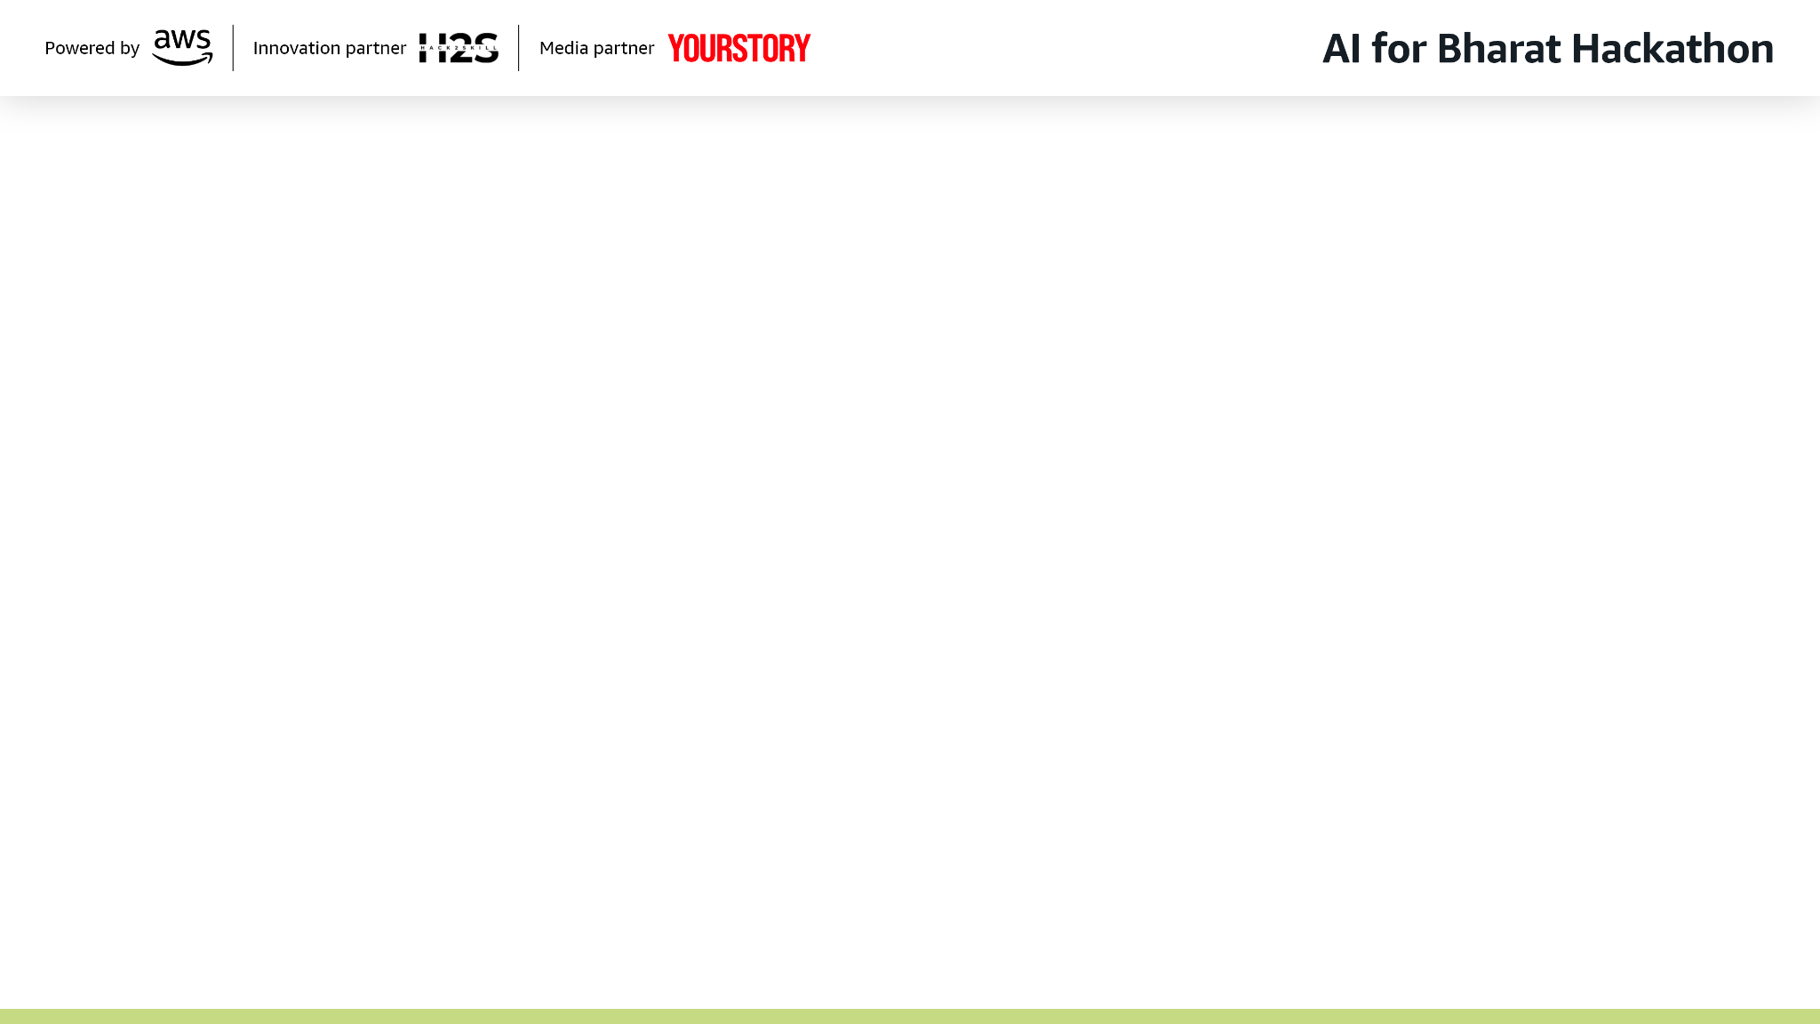
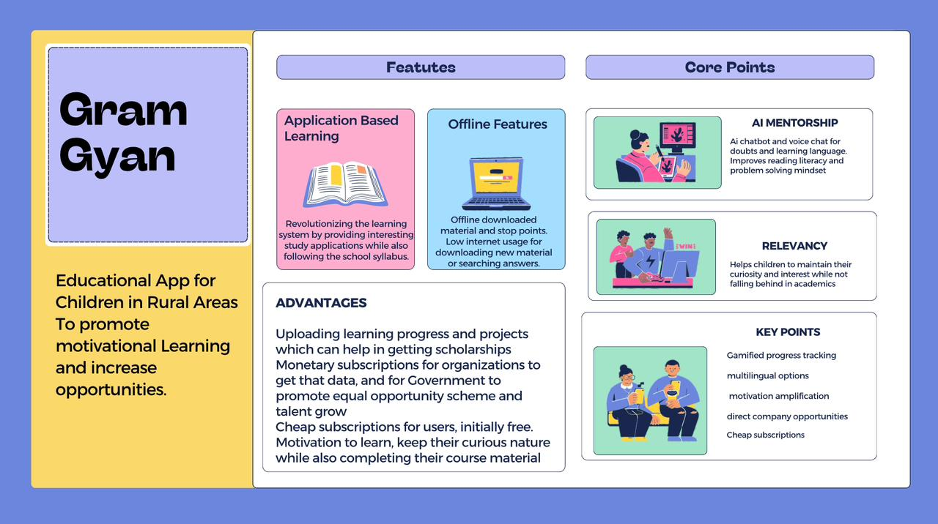

Slide 3
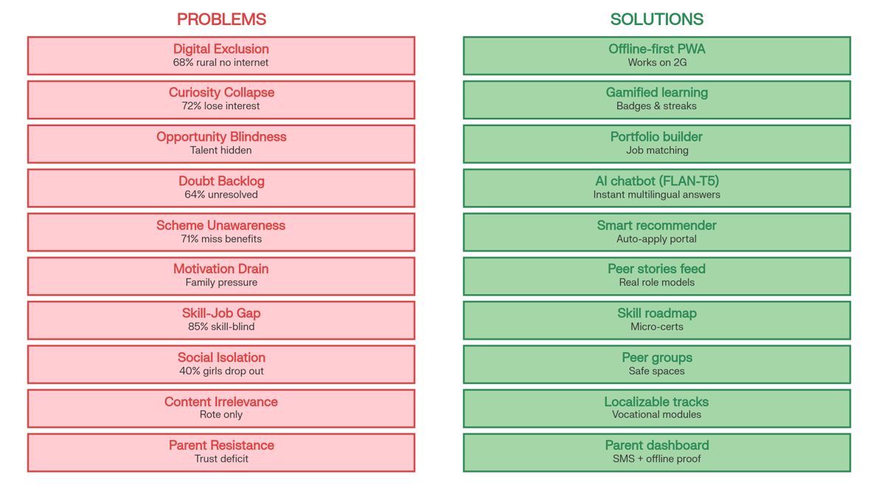

Slide 4
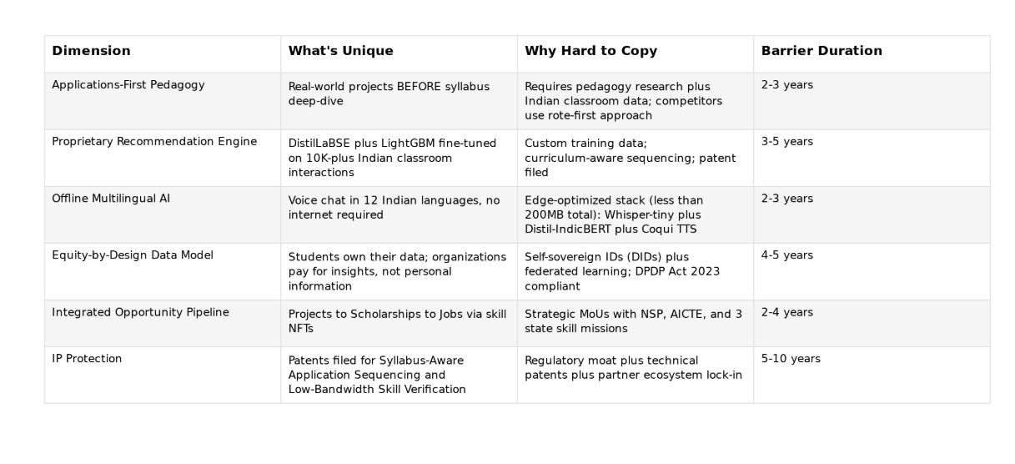

Slide 5
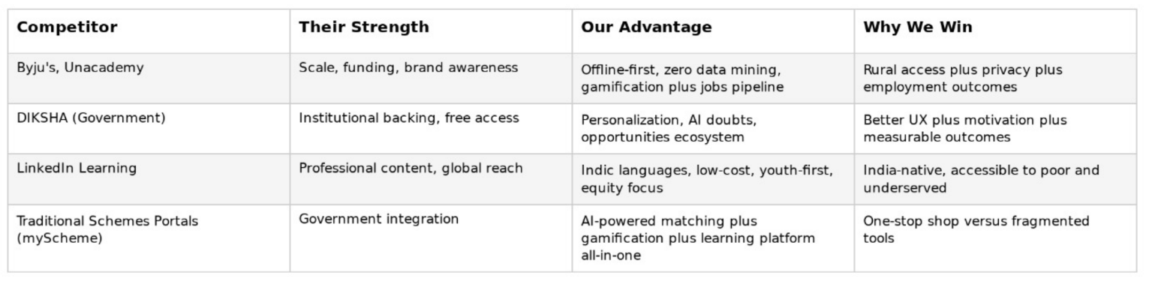

Slide 6
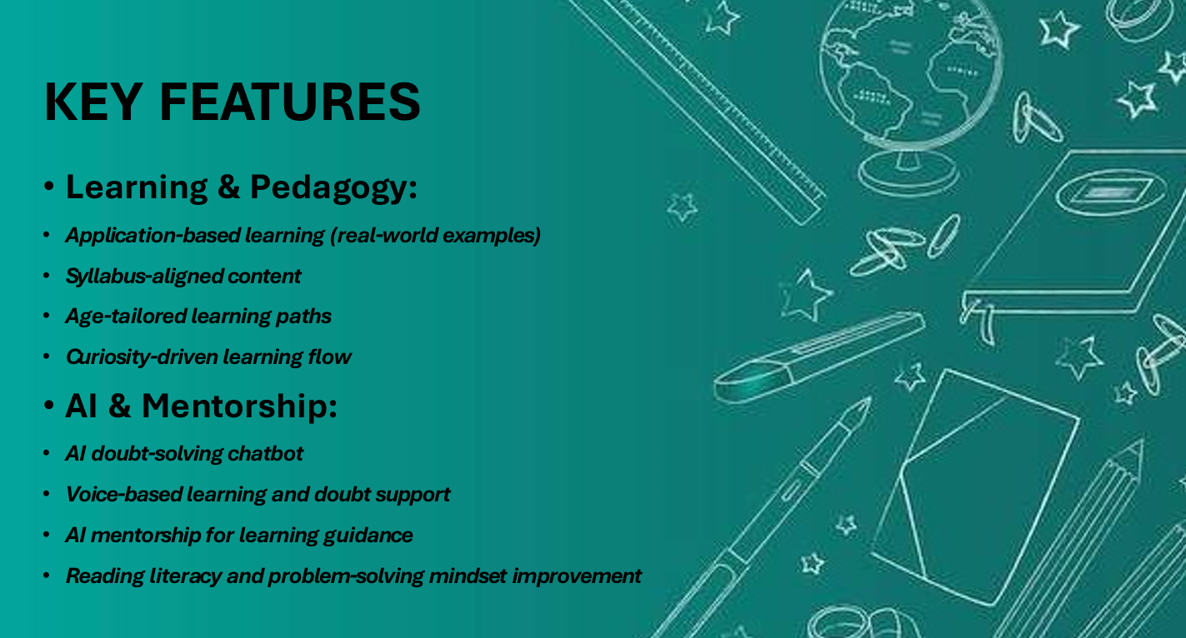

Slide 7
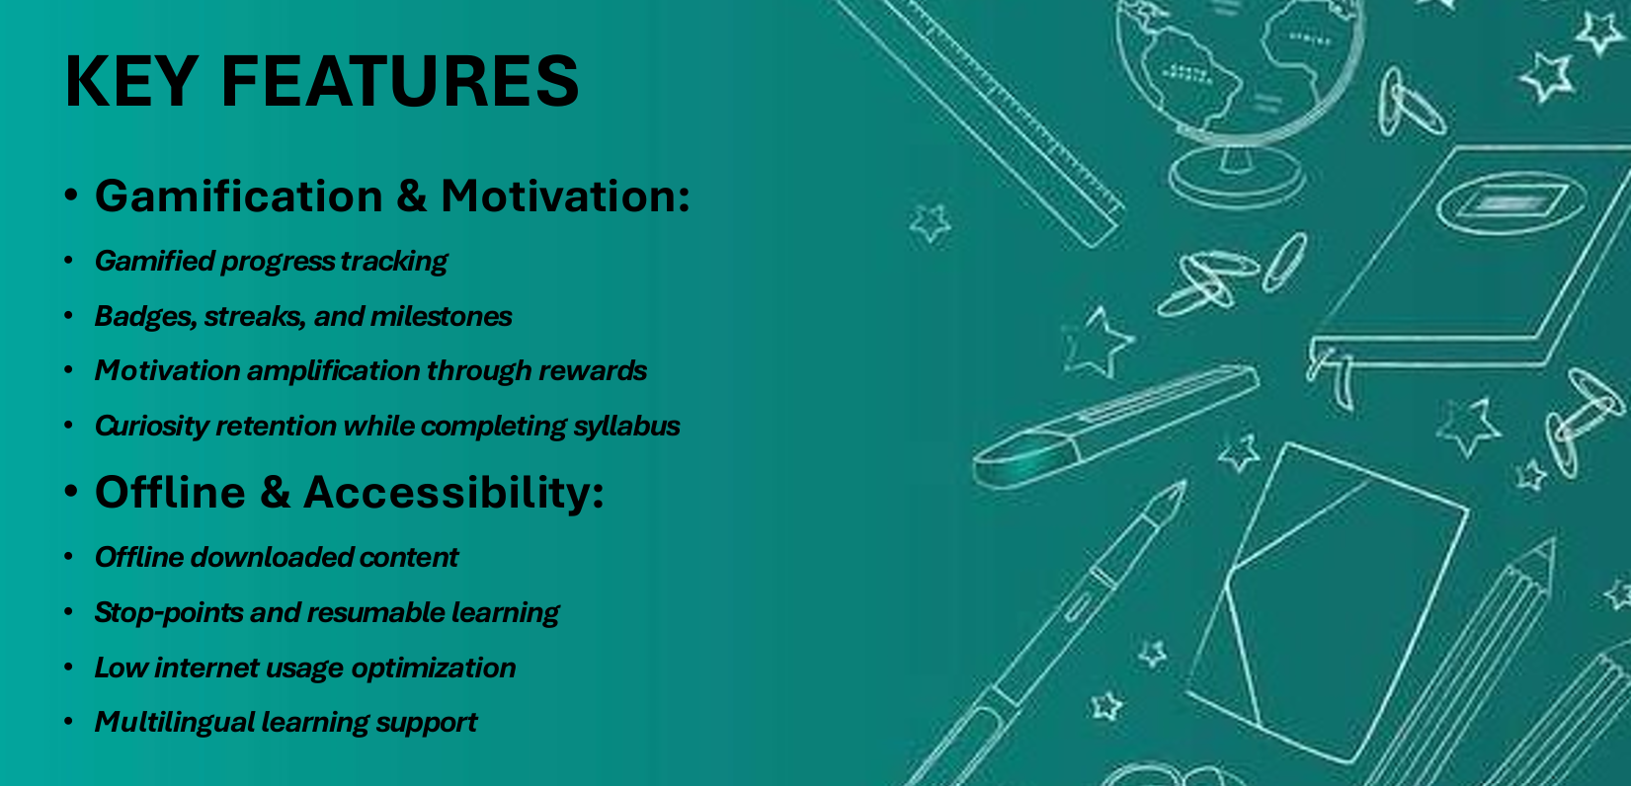

Slide 8

Wireframes/Mock diagrams of the proposed solution (optional)
ADVANTAGES & VALUE PROPOSITION
Uploading learning progress and projects
Digital portfolios for scholarships and opportunities
Affordable pricing with free initial access
Equal opportunity promotion through data visibility
Talent identification and growth support
Motivation without sacrificing curriculum completion

Slide 9
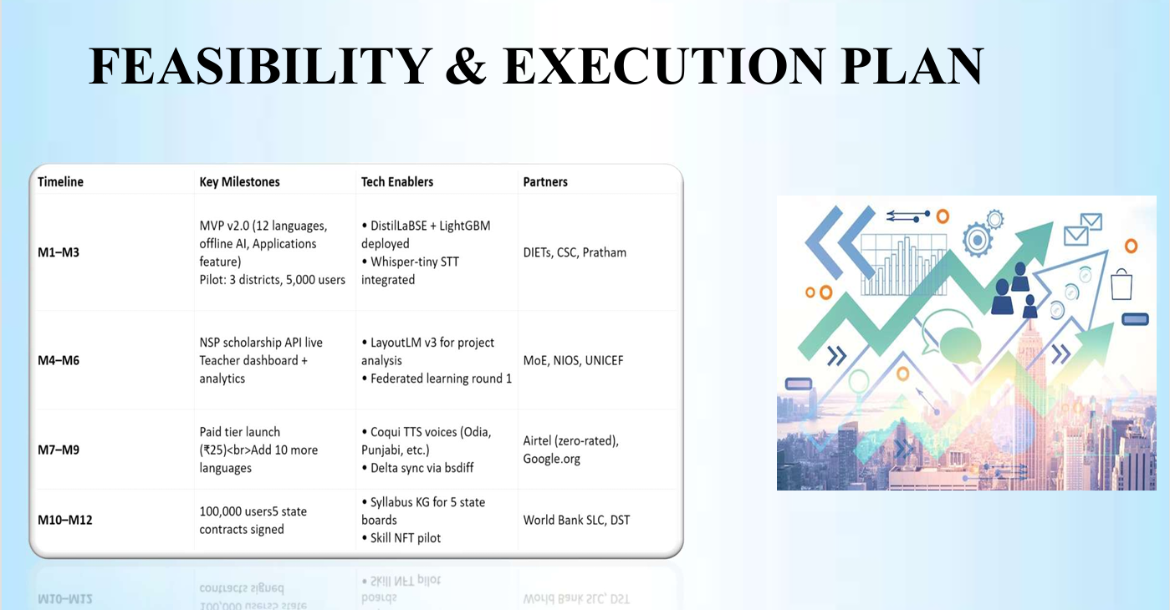

Slide 10
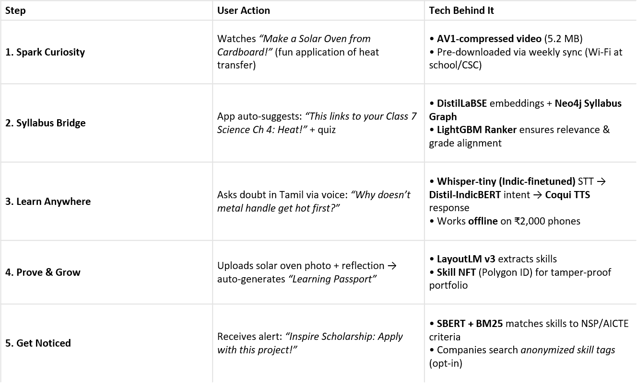
SOLUTION OVERVIEW

Slide 11
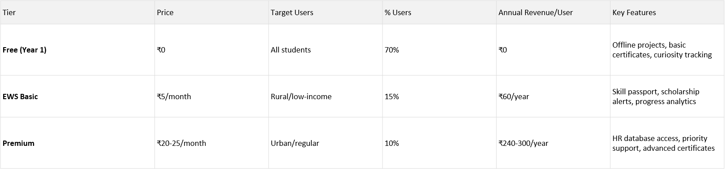
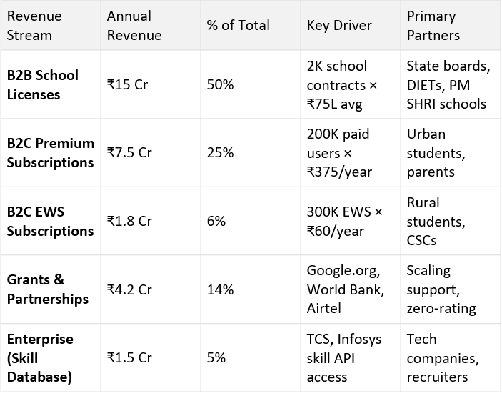
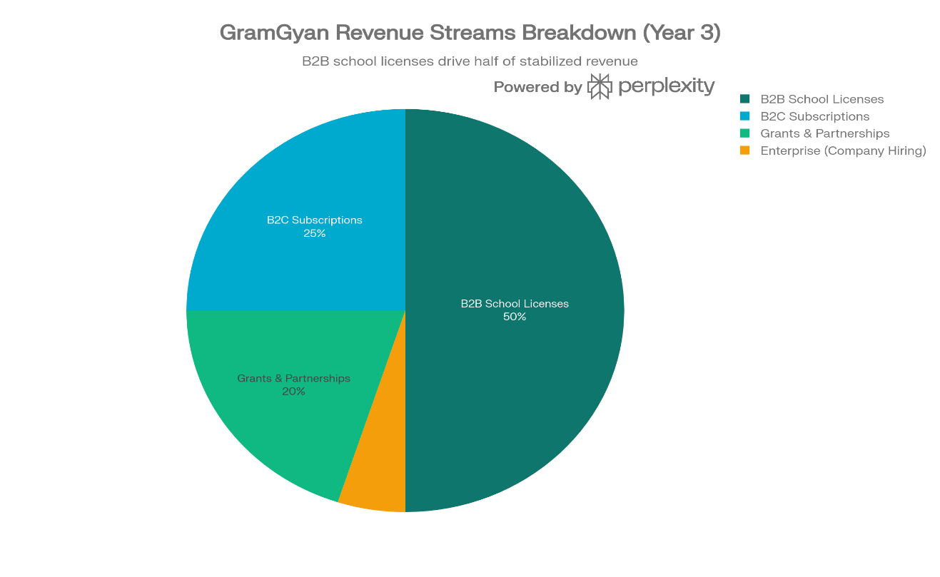
BUSINESS / REVENUE MODEL

Slide 12
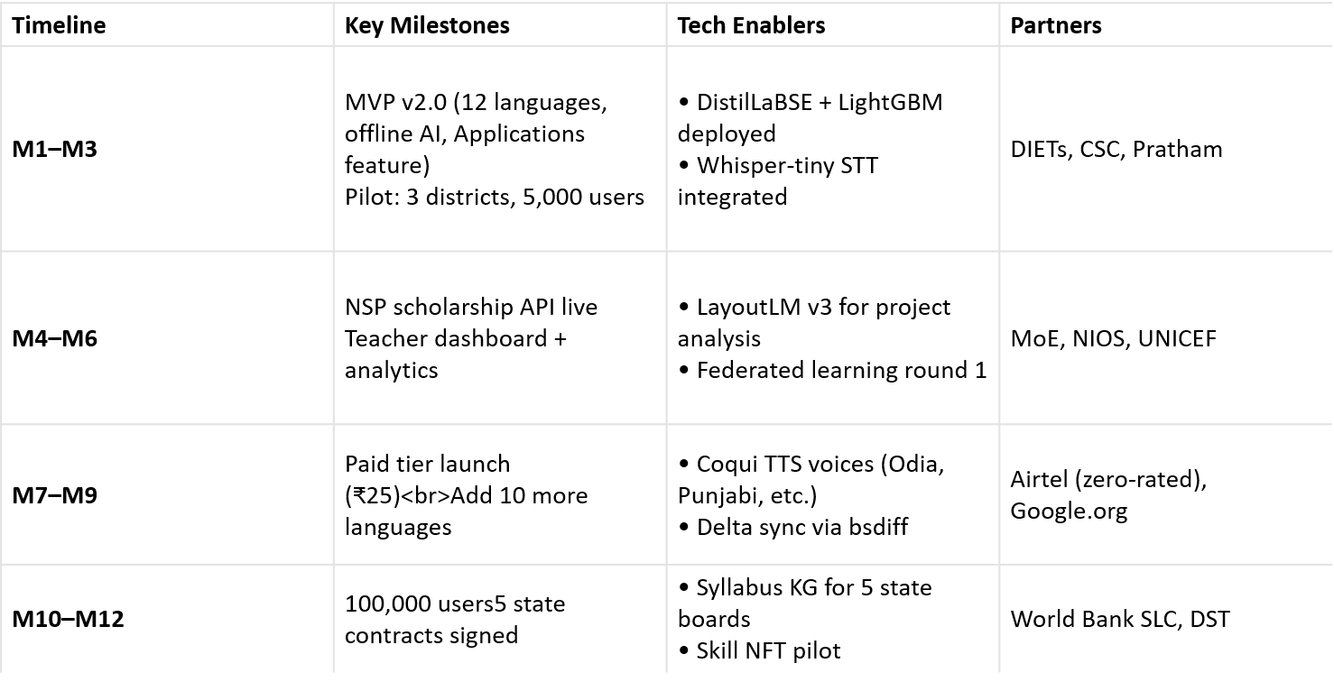
FEASIBILITY & EXECUTION PLAN

Slide 13

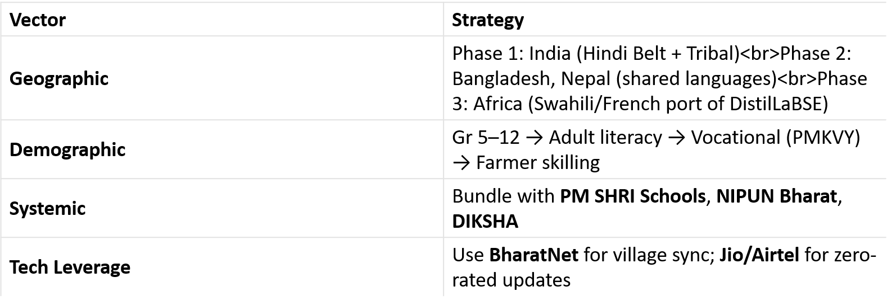
SCALABILITY & GROWTH
Add as per the requirements for the hackathon:
🌟 Vision 2030:
Every rural child graduates with a digital learning passport — curiosity intact, syllabus mastered, opportunities unlocked.

Slide 14
